Slide 1
ZOMATO RESTAURANT DATA ANALYSIS
BY :- ASHU KUMAR

Slide 2

Table of Content
Executive Summary
Introduction
Methodology
Results
Visualization – Charts
• Discussion
• Findings & Implications
• Conclusion
• Appendix

Slide 3
Executive Summary
Analyze the Bengaluru restaurant landscape to gain insights into popularity, customer satisfaction, and business performance.
Exploratory Data Analysis :-
After performing data cleaning, removing duplicates, conducting feature engineering, and visualizing the data, we have obtained valuable insights from the dataset.
Insights :-
A significant portion of restaurants offer online food delivery services, highlighting its importance.
Restaurants without table booking services tend to have lower ratings, emphasizing the impact of convenient booking options.
The BTM location has the highest number of restaurants, followed by Whitefield and Indiranagar, indicating popular dining destinations.
Fine dining, bar, quick bites, and lounge establishments are associated with higher costs.

Slide 4
Introduction
Nature of the Analysis :-
The analysis conducted in this project is exploratory in nature.
Problem Statement :-
The analysis seeks to address the following questions:
What is the proportion of restaurants in Bengaluru that offer online food delivery services?
Is there a relationship between table booking services and restaurant ratings?
Which locations in Bengaluru have the highest number of restaurants?
How do different restaurant types relate to their ratings?
What insights can be derived from the data to guide decision-making for restaurant owners, customers, and investors?

Slide 5
Methodology
Data Sources :-
The analysis utilizes a dataset of restaurants in Bengaluru, obtained from kaggle.
Methodology for this Project :-
• Data Collection (From Kaggle)
• Data Wrangling
• Data Exploration
• Data Cleaning
• Data Visualization
• Python matplotlib & Seaborn
• Summary & Insights

Slide 6
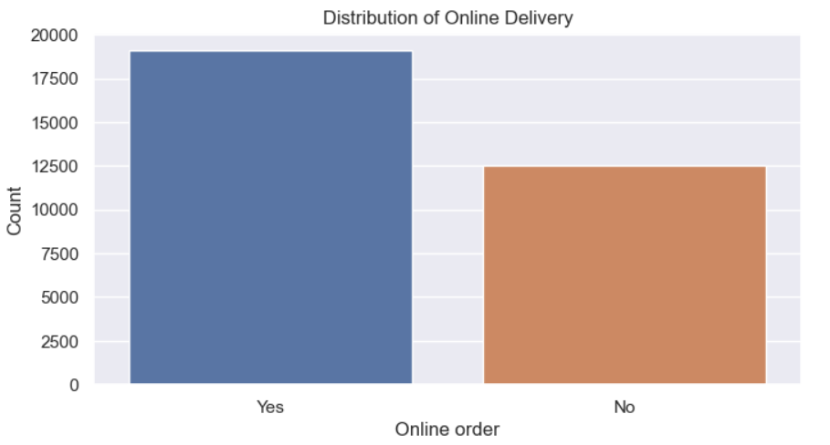
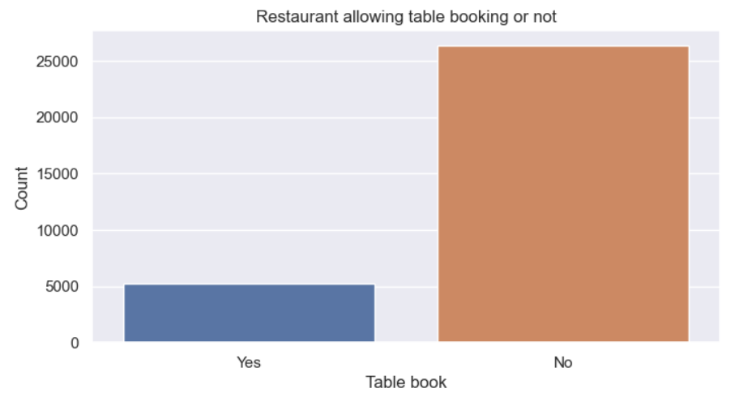
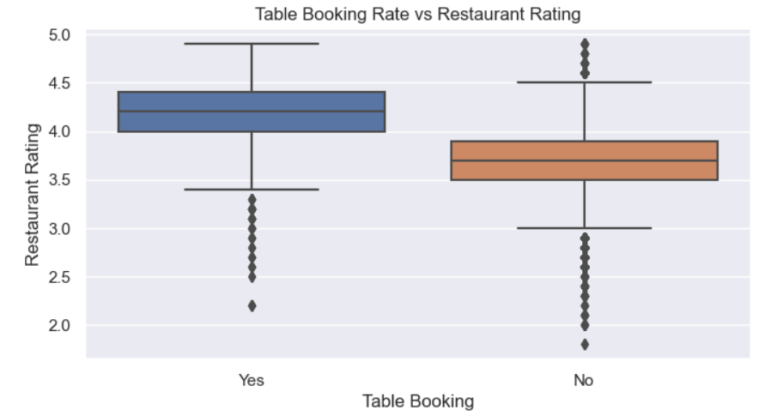
Results
The majority of restaurants provide online food delivery services.
A significant portion of restaurants do not offer table booking services.
Restaurants that provide table booking services tend to have higher ratings.

Slide 7
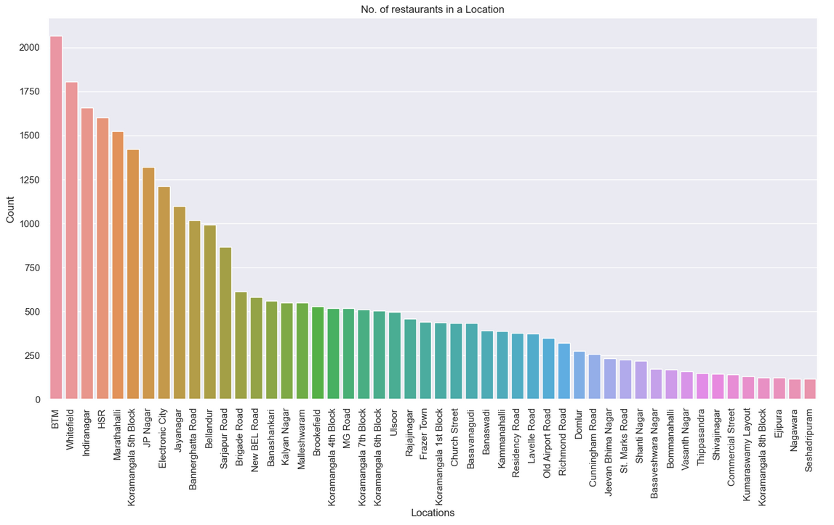
Results
The BTM location boasts the highest concentration of restaurants, followed by Whitefield, Indiranagar, and other locations.

Slide 8
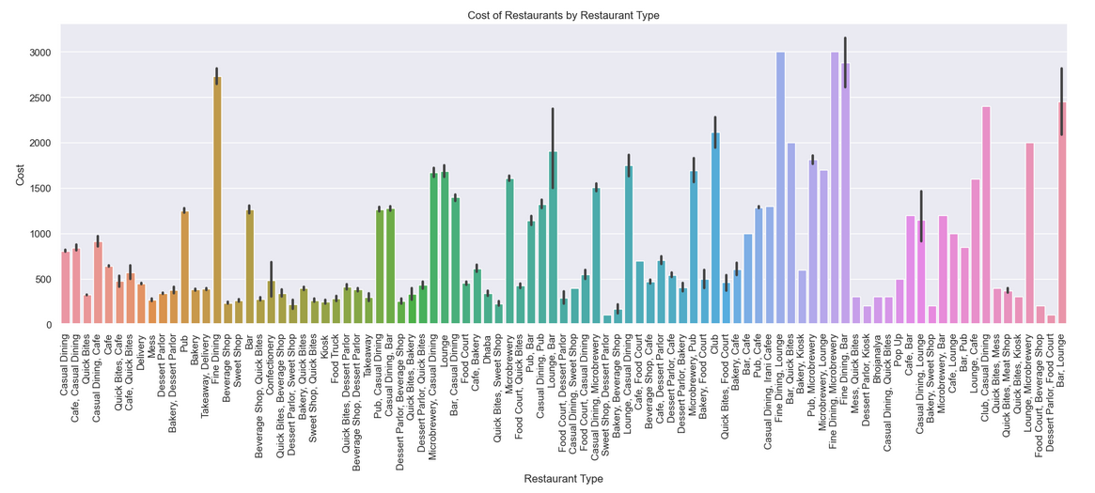
Results
Restaurant types such as "Fine Dining," "Bar," "Quick Bites," and "Lounge" are commonly associated with higher costs or expenditures. This suggests that customers generally allocate more financial resources when dining at these establishments compared to other restaurant types.

Slide 9
Discussion
Findings
Majority of restaurants provide online food delivery services.
Significant portion of restaurants do not offer table booking services.
Restaurants that provide table booking services tend to have higher ratings.
The BTM location boasts the highest concentration of restaurants, followed by Whitefield, Indiranagar, and other locations.
Restaurant types such as "Fine Dining," "Bar," "Quick Bites," and "Lounge" are commonly associated with higher costs.
Implications
Restaurants should prioritize adding food delivery services
Offering table booking services can enhance ratings and customer satisfaction for restaurants.
Strategic location selection in high footfall areas can contribute to increased visibility and business growth.
Targeting high-spending customers can lead to improved profitability for restaurants.

Slide 10
Conclusion
Problem :-
Understanding the restaurant landscape in Bengaluru and factors influencing popularity, customer satisfaction, and business performance.
Findings :-
Significant portion of restaurants offer online food delivery services.
Restaurants without table booking have lower ratings.
BTM location has the highest number of restaurants, followed by Whitefield and Indiranagar.
"Drinks & Nightlife" and "Buffet" restaurant types receive higher ratings.
Outcome :-
Valuable insights for decision-making by restaurant owners, customers, and investors.

Slide 11
Appendix
The data was downloaded from Kaggle
THANK YOU!

